Slide 1

Financial Barriers Facing First Generation College Students
7.21.2016
Joanne Dashiell, Manager of Professional Services, ASA
Jacqueline Moreno, Managing Director of College Access Initiatives, ISAC
Notes:
Intentional Tactics For Improving College Access And Educational Planning
The importance of educational planning and college access remains a significant national agenda item as well as a personal barrier for too many. This session focuses on case studies that utilize intentional tactics for improving college access and educational planning – both on an institutional level, driving individual goal setting and actions, and on a broad scale, leveraging technology and partnerships to expand reach. Organizational outcomes and student success measures are shared, and participants are encouraged to discuss their organization’s initiatives, to add to the collective work that we share for helping the next generation of students achieve their dreams.

Slide 2
Agenda
The need for economic competency
The importance of access and planning
Tactics for improving access and planning
Resources

Slide 3
The need for economic competency

Slide 4
Understanding Different Economic Realities
“My welfare worker told me I needed money management classes so I could stop being evicted.”
- Donna M. Beegle, Phd

Slide 5
Monoeconomic Experience
Members of an organization are from the same economic background and have little to no exposure to other economic experiences
Informational services are received only if individuals conform to expected rules, norms, and communication styles
All families are expected to exhibit the same behaviors related to time, paperwork, and participation
Differences in resources, priorities, experience, literacy, and culture are not integrated into outreach and communication (Beegle, 2007)

Slide 6
Economic Competency
Organization members meet people where they are and help them work through the system using multiple formats including coaching and mentoring
Staff understand that when families have unequal resources providing additional support is an expectation not an accommodation
Policies and procedures are created with the flexibility to provide exceptional service to individuals from every economic background
Training includes poverty competency and an explanation of barriers that families may be facing (Beegle, 2007)

Slide 7
Elements of Oral Culture
Relationships are of primary importance, personal trust must be established before information will be trusted, information is only obtained from trusted sources
Personal stories are used to convey important information
Spontaneity, including interruptions and tangents are accepted, and are normal parts of communication
Stories are repeated over and over in order to ensure information is understood and remembered
Emotions – all emotions – are part of conveying the ‘story’
Physical gestures help in communicating emotion
The big picture, not the details, are important
(Beegle, 2007)

Slide 8
Bridging the Communication Gap
Use memorable stories to convey important information
Model appropriate behavior in supportive ways
Develop relationships while sharing information
Use simple and familiar words and memorable examples
Give information verbally, repeat the information often
Use mentors and coaches when possible
(Beegle, 2003)

Slide 9
For more information
See Poverty….Be the Difference!
Discover the Missing Pieces for Helping People Move Out of Poverty
Dr. Donna M. Beegle 2007

Slide 10
The Importance Of Access And Planning

Slide 11



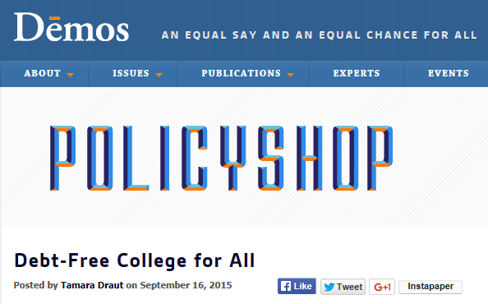
National Agenda

Slide 12
College Enrollment Gap
In 2012 the overall college enrollment rate was 67 percent for high school graduates
82% of students from the highest family income group transitioned directly to college
66% of students from the middle 60 percent of family incomes continued to college
52% of high school completers from the lowest income quintile enrolled in a two- or four-year college for the fall term following high school completion
Source: NACAC
Notes:
Iinfo from NACAC SOCA 2015 and NACAC StepbyStep PPT 2012
There are persistent gaps in rates of transition from high school to postsecondary enrollment among different groups of students.
-------------------
Counselors at schools with the highest proportion of students eligible for free and reduced lunch reported lower total college enrollment rates and much lower four-year college enrollment rates for their graduates
Counselors at schools with more students in the FRPL program reported
that their schools’ graduates had higher enrollment rates at two-year
colleges.10 In addition, students who graduated from private high schools
were much more likely to enroll in postsecondary education immediately
after high school than students from public high schools, and they were
nearly twice as likely to enroll in four-year colleges (see Table 3).11

Slide 13
Challenges To Low-Income College Affordability
Income : college cost ratio
Social trust and college financing
Lack of available resources and information
Cultural money practices of low-income families

Slide 14
Income : College Cost Ratio
Average income was lower in inflation-adjusted dollars in 2013 than it had been in 2003 for all but the highest-income families.
Income Increase between 1983 and 2013 (in 2013 dollars):
Top 20% = $70,821
Middle Quintile = $8,936
Lowest Quintile = $578
College cost increase for four-year in-state between 1983-2013 (in 2014 dollars) = $ 6,324
Top 20% = 9% of income
Middle Quintile = 70%
Lowest Quintile = you do the math!

Slide 15
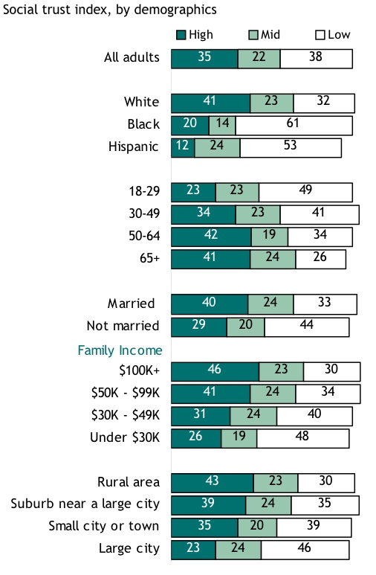
Social Trust And College Financing
Social Trust: A generalized faith in the “other.” A “faith in people.” (Pew Research Center, 2007).
Determined by historical relationships with social institutions (ex. Schools, banks, police, DMV).
Decreased faith in social mobility, equity in merit, life chances.
Impact on perceptions of loans/debt, school as an engine of change, conflict and skepticism over government (FAFSA), college/university personnel, banks, etc.

Slide 16
Lack Of Available Resources And Information
Students who pay for additional counseling are likely to have higher grades, higher SAT scores, and come from families with higher incomes (Avery, 2009).
Low-income students are underserved by high school counselors (Haskins, Holzer, Lerman, 2009).
Increasing access to school counselors has been shown to increase college-going (Hurwitz & Howell, 2013).
Providing hands-on FAFSA assistance plus financial aid information has been shown to increase enrollment and persistence (Bettinger, et.al., 2012).
Notes:
Students who pay for additional counseling are likely to have higher grades, higher SAT scores, and come from families with higher incomes: According to the Independent Educational Consultant Association, 22 percent of students applying to competitive colleges receive individualized counseling beyond what is offered by their high school counselors.
Low-income students are underserved by high school guidance counselors: High schools serving predominately low-income and minority students have counselor to student ratios twice the national average – 1,000 students per counselor versus 470 students per counselor nationally
Increasing access to school counselors has been shown to increase college-going: Adding one additional high school counselor increases four-year college enrollment by 10 percentage points. That is, if a typical high school serving 113 seniors hired one additional counselor, 11 more seniors would enroll in a four-year school.
: The H&R Block FAFSA experiment increased the FAFSA application rate 40 percent and college enrollment by 29 percent. High school seniors who received FAFSA assistance were 8 percentage points more likely to have completed two years of college.

Slide 17

Cultural Money Practices Of Low-Income Families
Low-income parents are supportive, encouraging, and at times active participants in the college-going process.
Parents operate on multiple financial fronts – primary focus on meeting family financial obligations.
College costs therefore seen as outside immediate family obligations.
Impact:
  Low-income children are often navigating the aid process on their own.
  Decisions resulting from this navigational process are often contingent upon parental approval!
Source: Calderone, 2015

Slide 18
Undermatching And/Or Revising Of Decision-Making
Undermatching: When an academically qualified student chooses to attend a higher education institution that is “less selective” than their academic ability.
Half of all low (SES) students undermatch.
Only 8 percent of high-achieving, low-income students are “achievement typical” in their application patterns.
Students often undermatch because of:
  Implied risk (to family) represented in assuming college-associated costs.
  Cheaper alternatives exist (i.e. community college, vocational programs, part-time enrollment.
  Low-income children are often navigating the financial aid process – and minimally supported by adult “others”.
Notes:
Low-income students are more likely to undermatch: Half of all low-socioeconomic status (SES) students undermatch, and low-SES students are more likely than their high SES peers to undermatch.
Only 8 percent of high-achieving, low-income students are “achievement typical” in their application patterns, meaning they applied to institutions that closely matched their abilities, including at least one selective safety school.

Slide 19
Focus On Affordability
Lack of knowledge regarding college financing
Sticker versus net price
Price sensitivity
Myriad of available resources and information
Notes:
Let’s take a moment to simply focus on the affordability piece. (Go through the example first off of sticker vs. net price – this slide plus the next one.)

Slide 20
Sticker Price Vs. Net Price
    In-state public four-year college:
      Average Sticker Price: $9,139
      Average Net Price: $3,030
    Private four-year college:
      Average Sticker Price: $31,230
      Average Net Price: $12,360
(ANP = price after subtracting gift aid and other educational credits for 2014-15 full time students)
Source: bigfuture.org
Notes:
Info from Big Future website
This info shows how with info there are more possibilities that you might imagine – but you will need to do some homework.
Consider what this means for your college search – do you need to start with financial stuff and then work to find great colleges that meet your needs…Or can you afford to search for “what you want” and then work on financial questions (may only be applicable for people who don’t have a cost concern).

Slide 21
Affordability
Lack of knowledge regarding college financing
Sticker versus net price
Price sensitivity
Myriad of available resources and information
Fearful of uncertainty in aid
Family pressure
Notes:
But it’s more complicated than just the lack of knowledge around sticker vs. net price. Changes in college pricing – from institution to institution – or from year-to-year at the same school (and knowing that you need to reapply each year, that there may be other opportunities or requirements)… Sometimes there is also simply information overload.
In addition there are real fears around whether aid will actually come through – or whether the student family will be able to come up with enough extra money each year to keep attending (part of the persistence puzzle). And there is often family pressure to make sure that the family is taken care – and that the student needs to help with that family financial obligation. Some families may also not see college as a priority (or not for their daughters).

Slide 22
Financial Literacy
Knowledge about money/personal finance
These students – and parents – often lack access to financial literacy resources
Also driven by cultural background
Lack of financial literacy can create:
Fear of the unknown
Inability to comprehend the process
Uncertainty around value of education
Fear of student loans
Fear of sharing required financial information
Stop outs in the process
Notes:
Financial literacy – including an understanding of the college financing/application process as well as the income reward on the other side of a degree – is an important piece of this puzzle.

Slide 23
Critical Challenges For All Students
Understanding the college process
School opportunities
Admission requirements
Financial aid process
Understanding long-term implications
Job opportunities
Debt impact
Return on investment
Resources!
Notes:
Just a general acknowledgement that the college process is complicated in both the short and long term. This is a problem for almost all students and parents.

Slide 24
Tactics For Improving Access
And Planning

Slide 25
Institutional Challenges
Ongoing fiscal challenges
Changing demographics
Transparency
Pressure to produce well-educated talent to meet workforce needs
Lack of services to identify, recruit, retain and graduate first-gen/low-income students
Increased educational attainment gap
Notes:
To acknowledge concerns that some attendees may not feel they have resources, etc. Set the stage for understanding.

Slide 26
If Finances Are An Issue…
Consider shifting your search hierarchy:
Academic
Social/emotional
Extracurricular
“X” factor
Financial
Figure out what you can afford first, then…
Determine aid eligibility
Create the universe of schools that might be financially feasible AND meet your other needs
Reminder: sticker price is not the same as net price

Slide 27
Programming Tips
Be intentional
Use existing resources and channels
Identify new channels
Sprinkle small sound-bites frequently to help consistently reinforce messaging
Understand your demographics

Slide 28
Actions
Partner with community based organizations
Hold events/provide information for both parents and students
  Consider language issues
Create checklists for important to-dos
Include financial aid/scholarship information in admission presentations
Hold “fly-ins” or other recruitment events
  Include all support opportunities for “college is possible” ideal
Notes:
Have our list of 6 possibilities. Put this in “action” mode for show – depending on audience.

Slide 29
Start The Conversation
The earlier the better
Parents and mentors need to be part of the conversation
Parent nights, PTA meetings, other gatherings of parents (prior to athletic events, theatre, music recitals – be creative!)
Notes:
Whatever you do, start the conversation!!
- Starting early in the school year, early in the educational process, in a variety of contexts…

Slide 30
ISACorps

Slide 31
The ISACorps
Near peer mentors
Recent college graduates
Placed in every community college district in the state
Complete financial aid certification prior to service
Serve two year commitments
Trained to help students with college planning including:
  FAFSA Completion
  Admission process
  Financial literacy
Notes:
Whatever you do, start the conversation!!
- Starting early in the school year, early in the educational process, in a variety of contexts…

Slide 32
Saltmoney.org

Slide 33
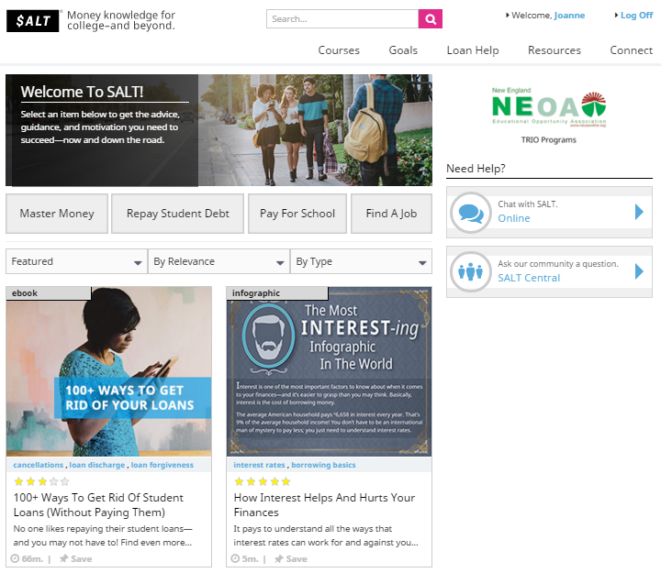

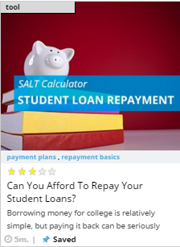
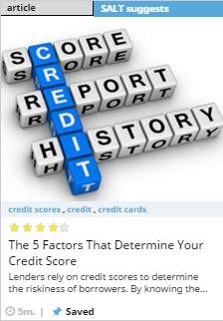



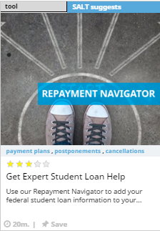


Saltmoney.org

Slide 34
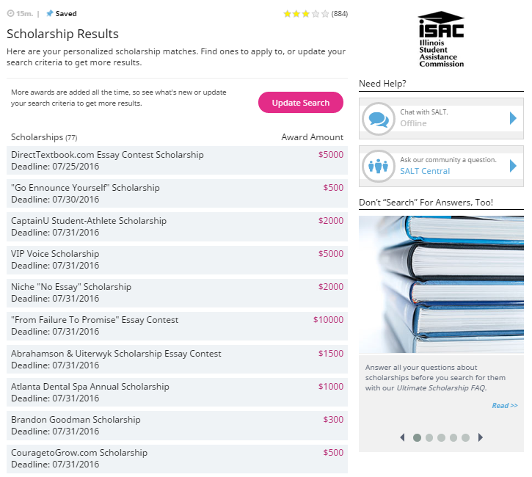
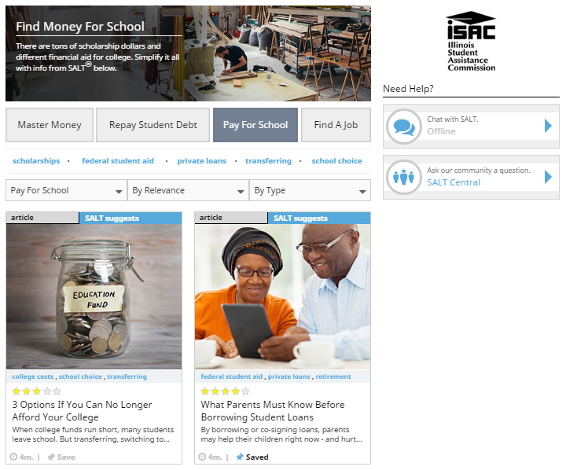

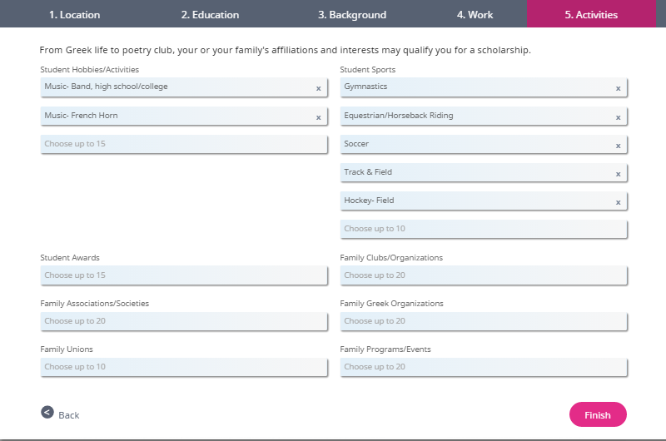
Scholarship Search
34
SALT CREATED BY AMERICAN STUDENT ASSISTANCE
Notes:
This is where the quick 3 minute video will go that quickly explains the SALT website – only used when needed.
Might be good to ask attendees to rate their knowledge of the SALT site on a scale of 1-5.

Slide 35
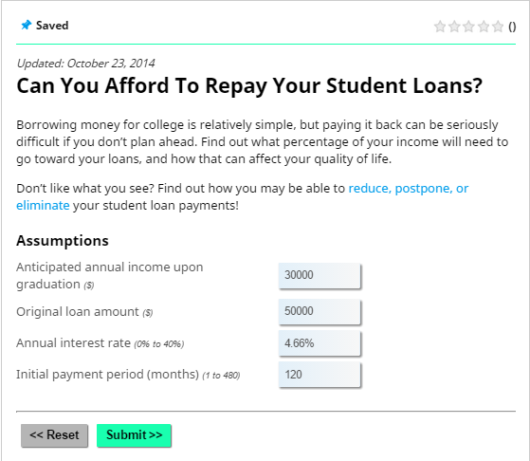
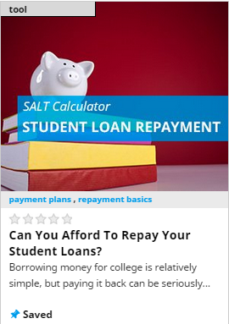
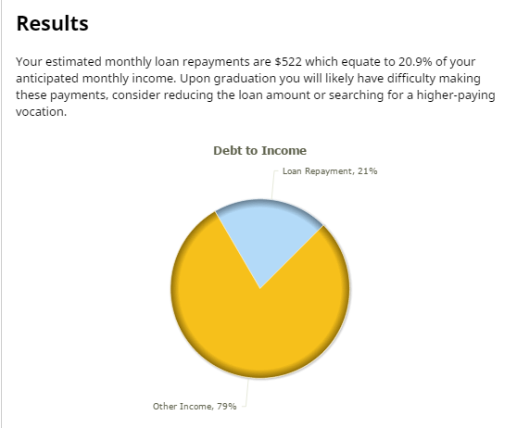
Loan Repayment Calculator
35
SALT CREATED BY AMERICAN STUDENT ASSISTANCE
Notes:
This is where the quick 3 minute video will go that quickly explains the SALT website – only used when needed.
Might be good to ask attendees to rate their knowledge of the SALT site on a scale of 1-5.

Slide 36
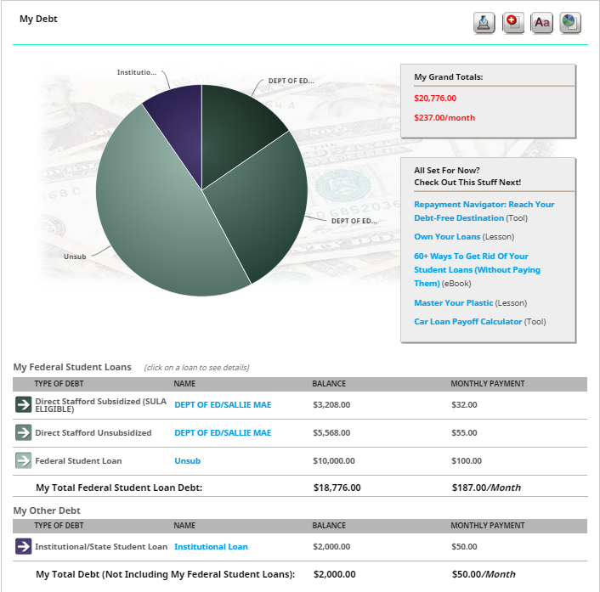
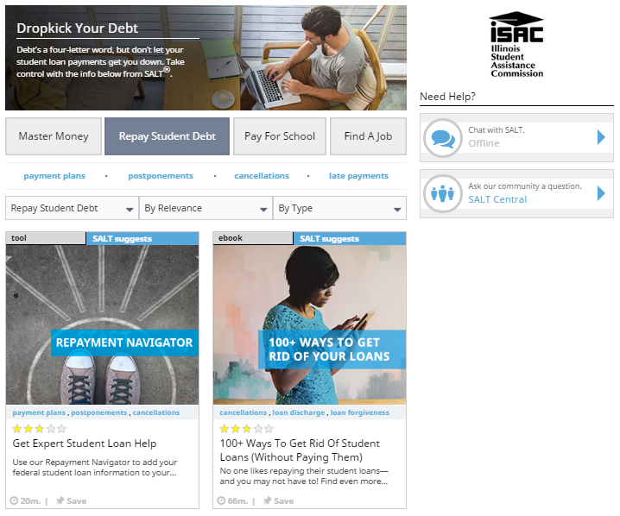
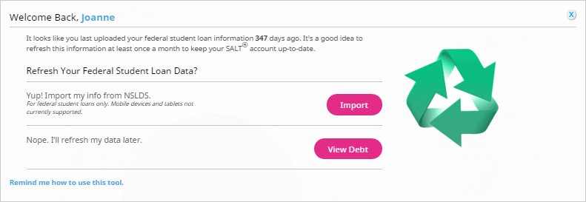
Loan Tracking
36
SALT CREATED BY AMERICAN STUDENT ASSISTANCE
Notes:
This is where the quick 3 minute video will go that quickly explains the SALT website – only used when needed.
Might be good to ask attendees to rate their knowledge of the SALT site on a scale of 1-5.

Slide 37
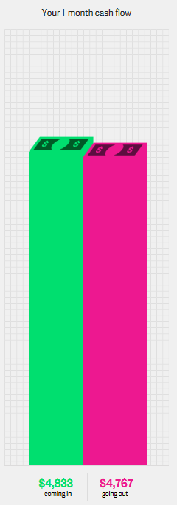

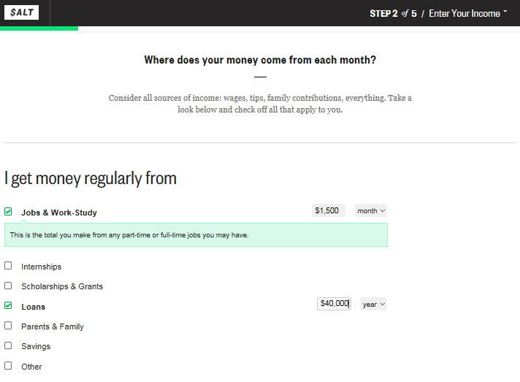
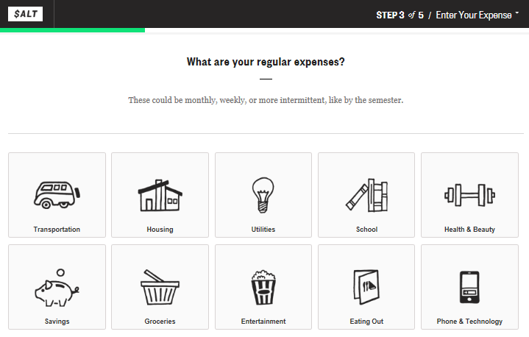
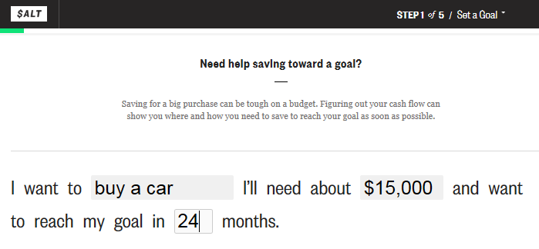
Cash Flow Lesson

Slide 38
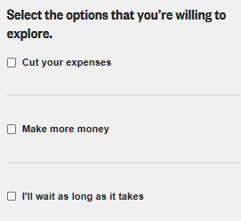
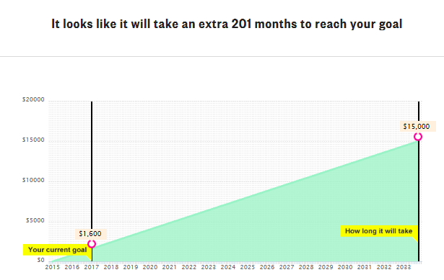
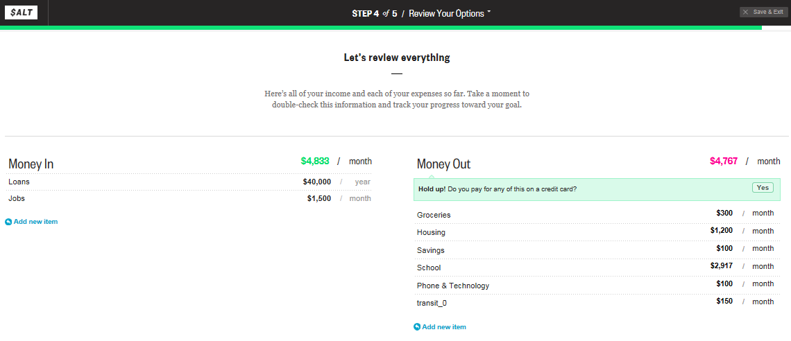
Cash Flow Lesson

Slide 39
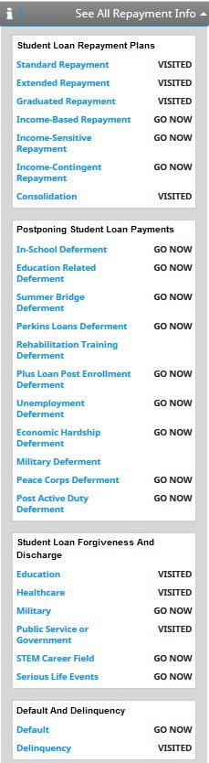
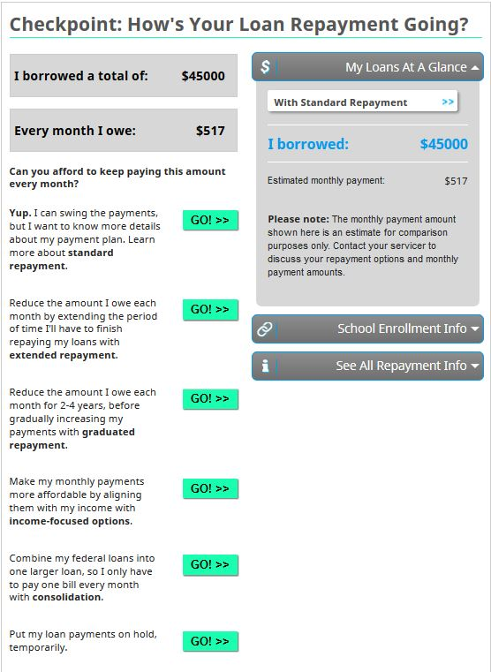
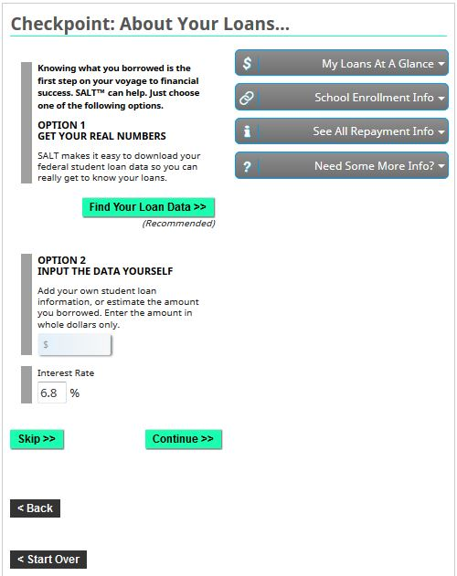
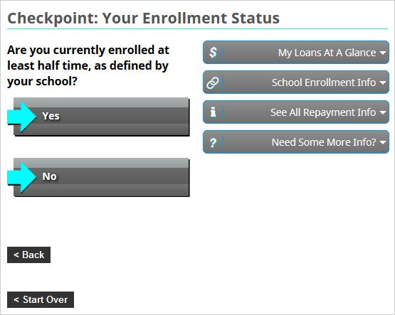
Repayment Navigator
Notes:
If you have student loans – or you’re thinking about borrowing – you can actually import your federal student loan data from the National Student Loan Data System (NSLDS). You can also estimate information about future loans you might borrow – and check out repayment plan options, the cost of your borrowing and more.
You will see a link to the Loan Navigator tool from the front page for SALT, in the bottom navigation bar, in the “Resources” tab under “Tools and Apps” or by using the search function.

Slide 40
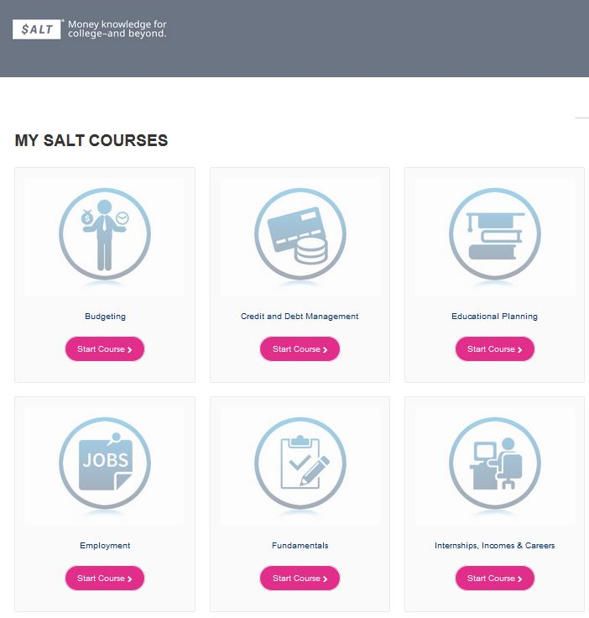
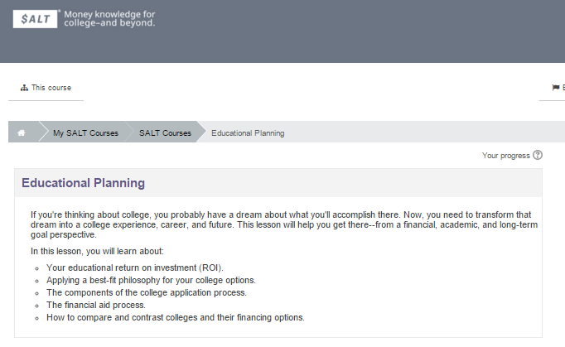
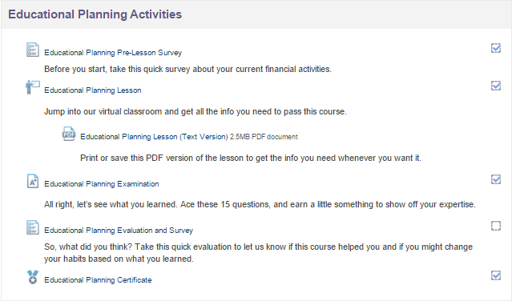
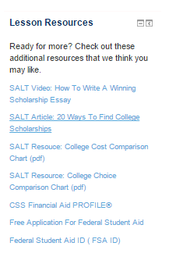
SALT Courses: Educational Planning

Slide 41
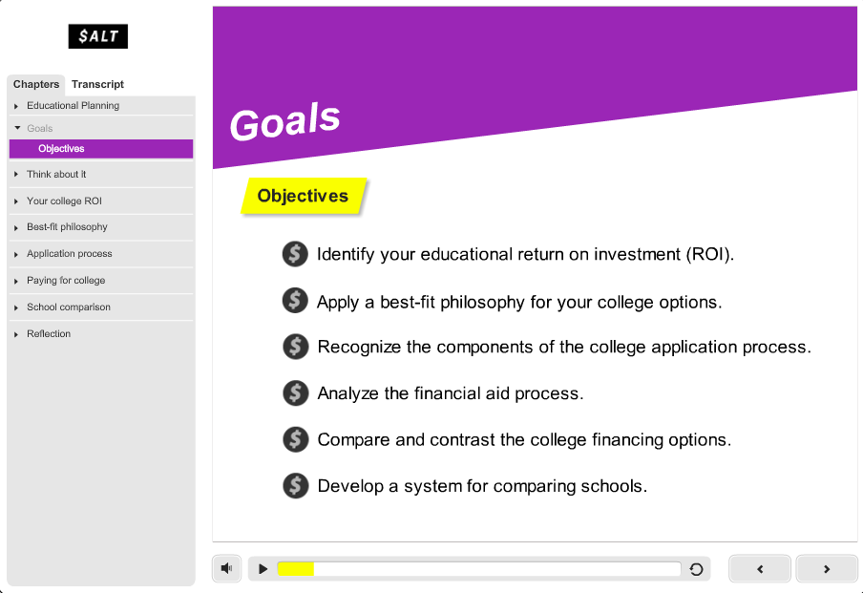
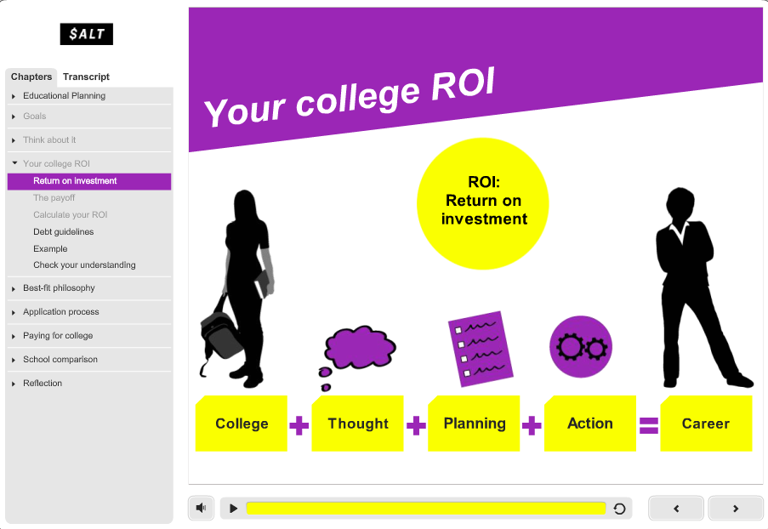
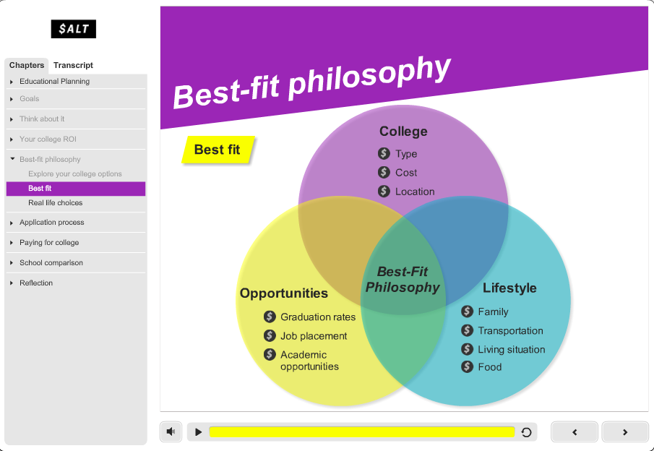
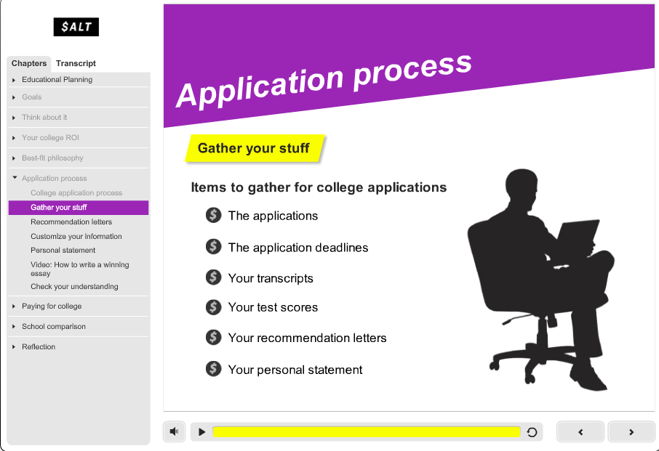
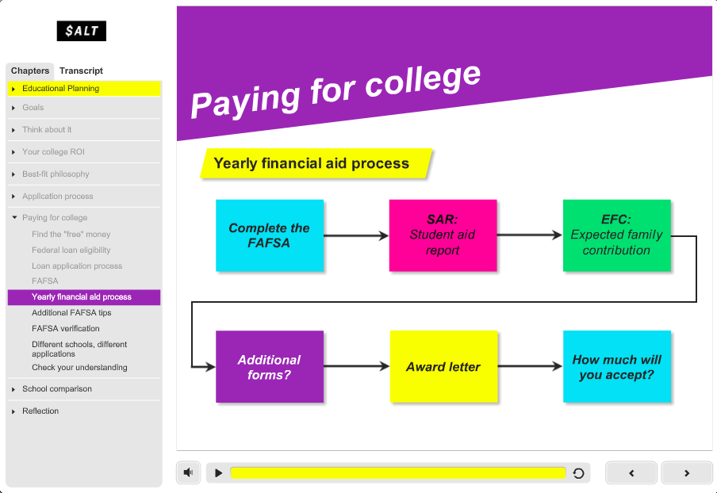
Educational Planning
41
SALT CREATED BY AMERICAN STUDENT ASSISTANCE
Notes:
This is where the quick 3 minute video will go that quickly explains the SALT website – only used when needed.
Might be good to ask attendees to rate their knowledge of the SALT site on a scale of 1-5.

Slide 42
American Student Assistance
800.999.9080
education@asa.org
asa.org/client-training
Notes:
Recommended:
Arial font for contact info, 50% black and 12 points

